Slide 1

THE POWER OF UNITY
BAPTIST CONVENTION
ASSEMBLY 2012
BY PASTOR V.J. SIGUDLA

Slide 2

What we mean by
“Diversity” in the Church

Slide 3
What we mean by “Diversity” in the Church
DIVERSITY IS COLOUR / RACE / NATION
- Diversity in the church is referred to as our brothers and sisters that have come from different countries, backgrounds, cultures, languages and ethnicities.
- The first century church was very diverse. We read of letters to the Romans, Corinthians, Ephesians, Galatians, to the Hebrews, Colossians, etc. Many nations were involved in the first century.

Slide 4
“Things which unite”
Division is very ugly, disgusting and tragic, but is even more when it comes to spiritual realms.

Slide 5
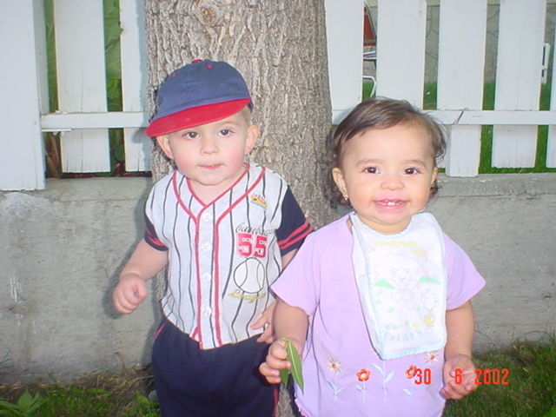
UNITY IS POSSIBLE!
Ephesians 4: 3-6...
“3endeavoring to keep the unity of the Spirit in the bond of peace. 4There is one body and one Spirit, just as you were called in one hope of your calling; 5one Lord, one faith, one baptism; 6one God and Father of all, who is above all, and through all, and in you all.

Slide 6

WE HAVE THE SAME SAVIOUR!
Titus 2:13...
Ephesians 5:23...
Philippians 3:20...
2 Corinthians 5:14-15...

Slide 7
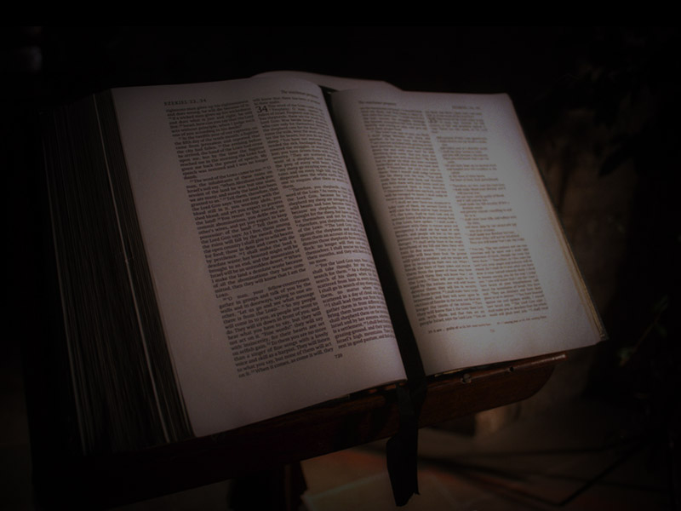
WE HAVE THE SAME BOOK THAT WE CAN ALL UNDERSTAND!
John 17:17
Ephesians 4:5…
1 Corinthians 1:10…
1 Corinthians 5:6,7…
Ephesians 4:3

Slide 8
WE HAVE THE SAME RACE TO RUN!
I Corinthians. 9: 24-27
Hebrews. 12: 1
2 Timothy. 2: 5

Slide 9

WE HAVE AN ENEMY THAT WE FIGHT!
2 Timothy. 2: 3-5
I Peter. 5: 8
Jude 3
Philippians. 1: 7, 17

Slide 10
WE HAVE THE SAME FAITH THAT WE MUST KEEP!
2 Timothy 4: 7, 8
Revelation 2: 10
1 John 5:4
Hebrews 12:2
Faith

Slide 11
4 Things That Hurt Unity
Lack of effort
Things that pull us together CAN push us apart, for instead in Pampierstad we were fragmented as Christians, the Bible and faith that could have brought us together pushed us apart until demons brought us together, SHAME ON US!!

Slide 12
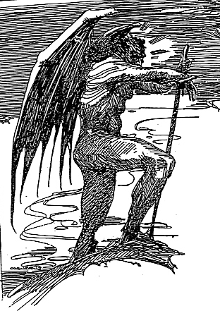
Lack of effort
Toward
Our ENEMY

Slide 13


Lack of effort
Toward
Our Foe
Toward
Sin

Slide 14

Lack of effort
Toward
Our ENEMY
Toward
Our Sin
Toward
Our Purpose

Slide 15
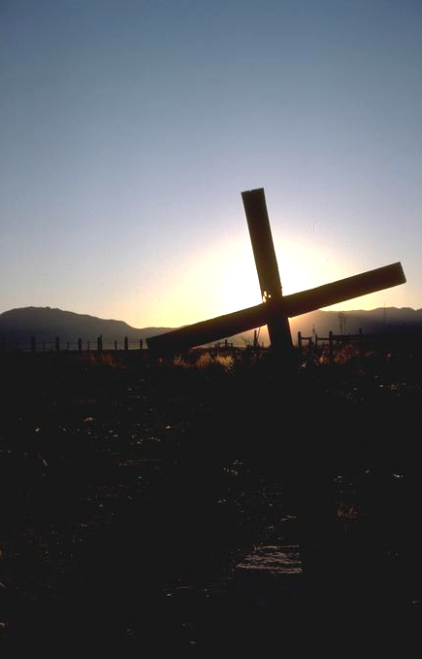
Lack of effort
Toward
Our ENEMY
Toward
Our Sin
Toward
Our Purpose
Toward
Our Salvation

Slide 16
4 Things That Hurt Unity
Exalting self
IT IS NO LONGER I THAT LIVES BUT IT IS CHRIST WHO LIVES WITHIN ME. GAL 2:20

Slide 17
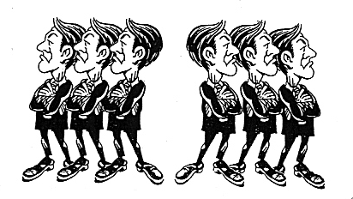
4 Things That Hurt Unity
Disorder. 1 COR 14:40

Slide 18
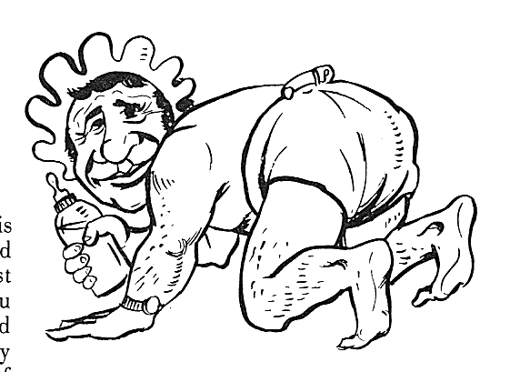
4 Things That Hurt Unity
Lack of growth

Slide 19
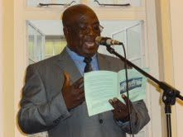
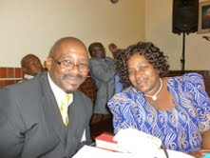
ARE WE AS A CONVENTION CHURCHES UNITED?

Slide 20
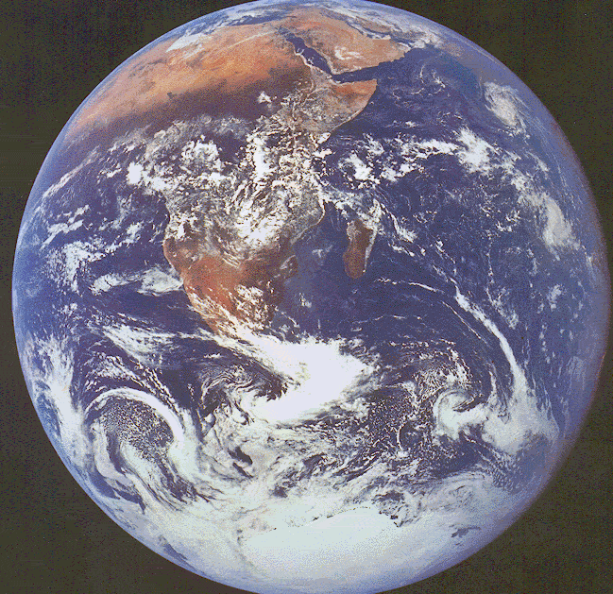
How can I become a Christian?
HEAR Acts 2:36
BELIEVE Acts 2:37
REPENT Acts 2:37
CONFESS Acts 2:38
BAPTISM Acts 2:38-41
SALVATION
FAITHFUL Acts 2:42-47
HEAR Acts 2:36
BELIEVE Acts 2:37
REPENT Acts 2:37
CONFESS Acts 2:38
BAPTISM Acts 2:38-41
SALVATION
FAITHFUL Acts 2:42-47

Slide 21

GOD IS NOT RACIST

